Slide 1
Unified Analytics Platform with Databricks & Apache Spark
Notes:
MIKE
So let’s begin….
Intros- around the horn on both sides

Slide 2



VISION
Accelerate innovation by unifying data science, engineering and business
SOLUTION
Unified Analytics Platform
WHO WE ARE
Original creators of , Databricks Delta &
2000+ global companies use our platform across big data & machine learning lifecycle
Notes:
Andreessen Horowitz
Our company’s goal from its inception almost 5 years ago was to truly help companies Accelerate their innovation cycles by bringing together & unifying DS, DE & business for the outcomes they want…
Our charter from the beginning is not only to Demystify the challenges that surround those areas, but to also Democratize the Data & the Science to allow customers… and not just the 1% companies (Uber/ FB, Netflix and others) to use this platform for a distinct business advantage.
We deliver our unified platform as a managed service in the cloud
We are the foremost experts in doing this…notably our founders are the six guys who created the Spark engine….which was the first unified engine for processing both Big Data & ML….and has become the de-facto OS standard in the industry. Databricks has industrialized spark exponentially and built an entire Secure Enterprise Platform that meets the needs of the modern enterprise.
mention customers, what we do etc. right now it is just a list of projects.

Slide 3

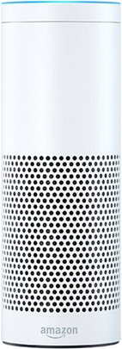

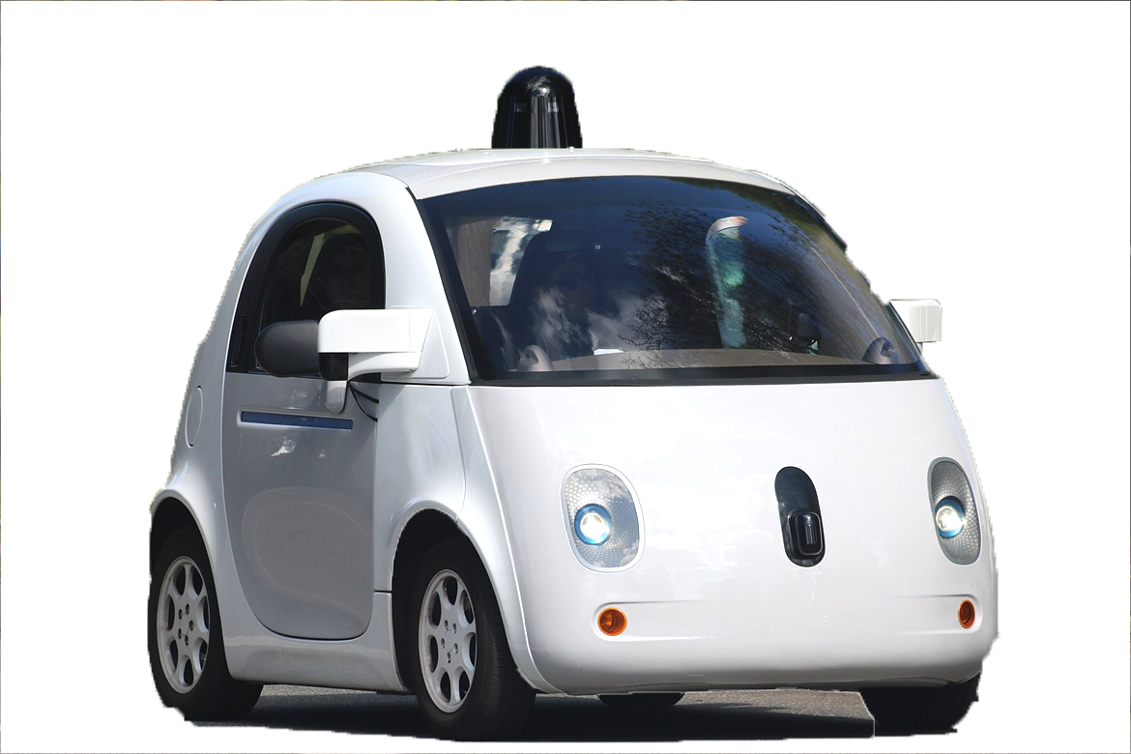


AI has huge promise
Huge disruptive innovations are affecting most enterprises on the planet
Transportation
Healthcare and Genomics
Internet of Things
Fraud Prevention
Personalization
and many more...
Through a Keystone Research study, companies in the top quartile that harness cloud, data and AI vastly outperformed companies in the bottom quartile by nearly doubling operating margins and realizing $100M in additional operating income.
Notes:
AI has enormous promise - it has the potential to drive disruptive innovations affecting most enterprises on the planet. It can drive competitive advantage, improve customer experience and reduce cost through automation today.

Slide 4
Hardest Part of AI isn’t AI, it’s Data
“Hidden Technical Debt in Machine Learning Systems,” Google NIPS 2015
Data
Verification
Machine Resource Management
Monitoring
Data Collection
Serving
Infrastructure
Configuration
ML
Code
Analysis Tools
Feature Extraction
Process
Management Tools
Figure 1: Only a small fraction of real-world ML systems is composed of the ML code, as shown by the small green box in the middle. The required surrounding infrastructure is vast and complex.
Notes:
Google, the leader in applying AI across their business published a seminal paper at NIPS in 2015. You can see all the capabilities that a company needs to have to be successful at AI… ML Code is the smallest green box at the center.
Everything else is about collecting, verifying and preparing data; configuring and managing cloud-scale infrastructure…. that’s where the heavy lifting is.

Slide 5
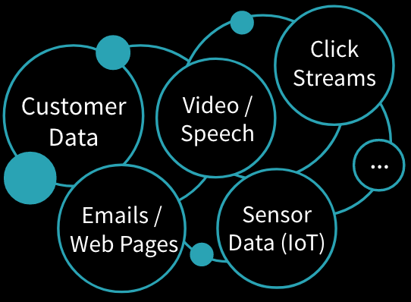





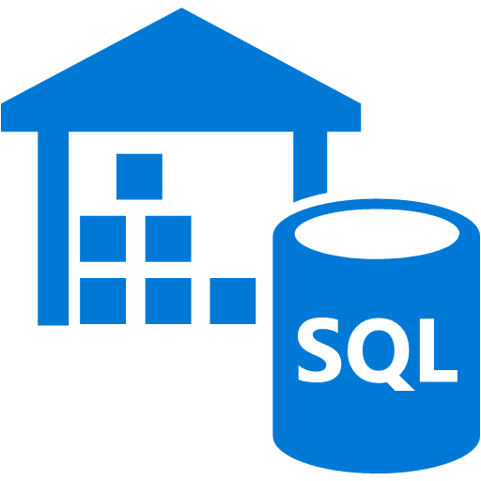



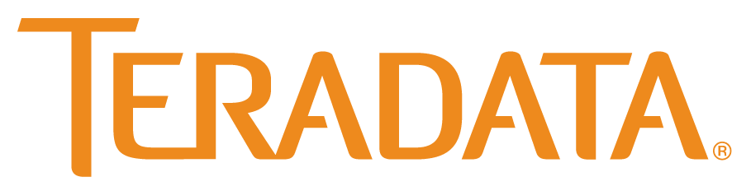



Data & AI Technologies are in Silos
x
Great for Data, but not AI
Great for AI, but not for data
Notes:
Enterprise data is itself siloed across hundreds of systems such as data warehouses, data lakes, databases and file systems that are not AI-enabled. This means an enormous amount of time is spent combining the data, cleaning and verifying the data, enriching the data, and featurizing the data to get it ready for the model.
AI frameworks such as TensorFlow, PyTorch, and SciKit-Learn don’t do data processing. They assume that the datasets are clean and you have pre-built data infrastructure to do the data processing.
These technology silos make it very hard for enterprises to succeed in AI without an army of highly sophisticated engineers and data scientists.

Slide 6
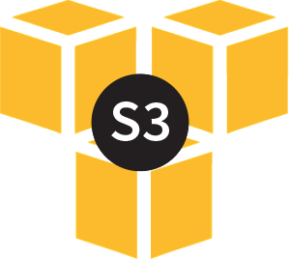

Apache Spark: The First Unified Analytics Engine
Uniquely combines Data & AI technologies
Runtime Delta Spark Core Engine
Big Data Processing
ETL + SQL +Streaming
Machine Learning
MLlib + SparkR
Notes:
Apache Spark was the first Unified Analytics Engine to bring Data and AI technologies together. It has become the de-facto data processing and AI engine in enterprises today due to its speed, ease of use, and sophisticated analytics.
Spark simplifies data preparation for AI by unifying data at massive scale across various sources - cloud storage systems, distributed file systems, key-value stores, and message buses.
Spark also unifies data and AI with a consistent set of APIs for data preparation as well as machine learning. MLlib and SparkR are native libraries that make a large number algorithms accessible to data scientists. It also supports various popular AI frameworks and libraries such as TensorFlow, PyTorch, R and SciKit-Learn.

Slide 7

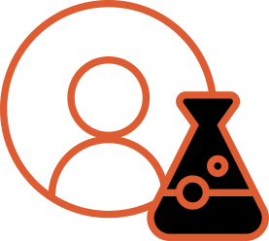
Enterprises face challenges beyond Apache Spark
Disconnect
Engineers
Scientists
Complex data pipelines and infrastructure
Unified Analytics Engine

Slide 8
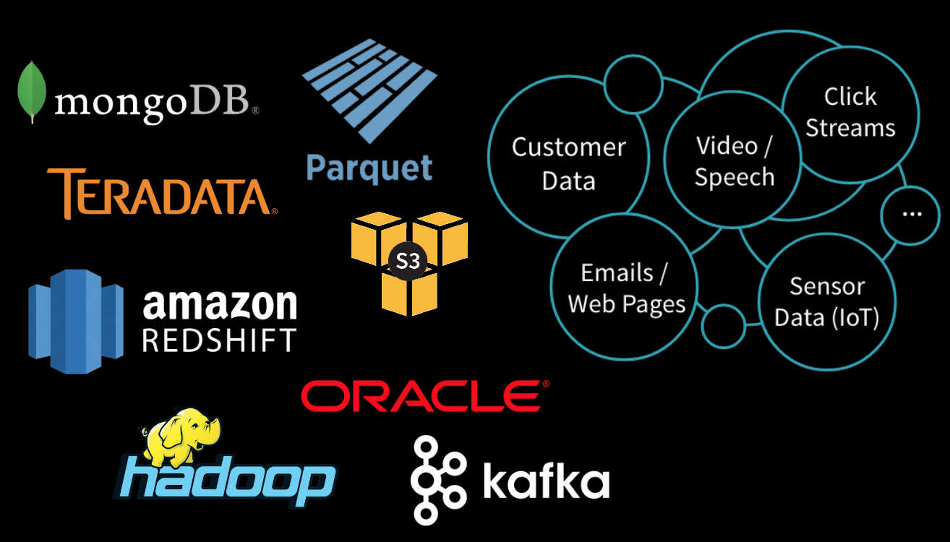


Data & AI People are in Silos
x
DATA ENGINEERS
DATA SCIENTISTS
Notes:
Data is in different places -- EXAMPLE Hadoop is great for DATA, not AI
EXAMPLE Tensorflow is great for AI, but can’t do processing
EXAMPLE Petabytes of logs streaming from devices to AI is NON TRIVIAL.

Slide 9

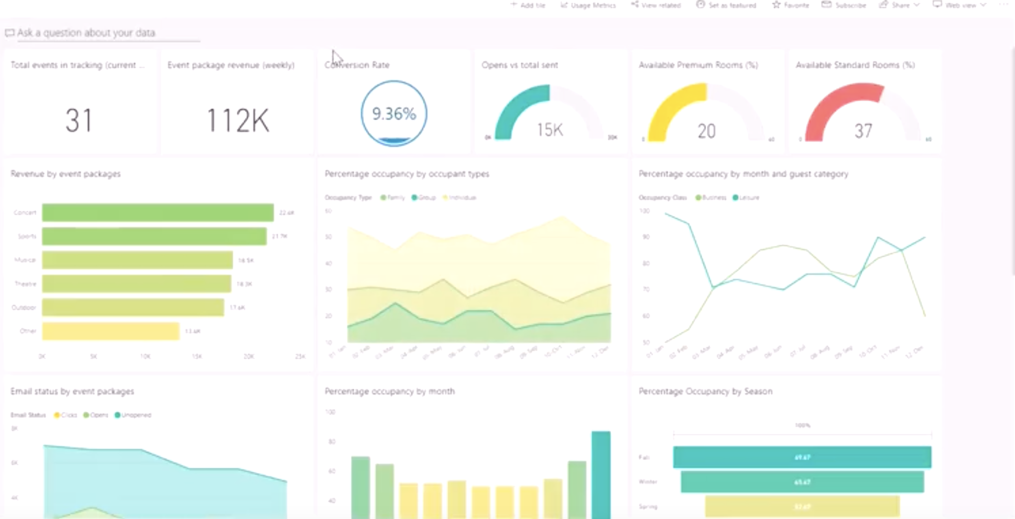










AZURE
DATA SOURCES
DATABRICKS COLLABORATIVE WORKSPACE
Notebooks
Blob Storage
Jobs
Models
Apis
Dashboards
Data Lake Store
DATA ENGINEERS DATA SCIENTISTS
SQL Data Warehouse
DATABRICKS RUNTIME
BI Reporting
Dashboards
Cosmos DB
for Big Data
for Machine Learning
Event Hub
Batch & Streaming
Data Lakes & Data Warehouses
IoT Hub
DATABRICKS CLOUD SERVICE
Security Integration
Azure Data Factory
Azure Portal
One-Click setup
Unified Billing
Notes:
We address these challenges with our Unified Analytics Platform. We provide a Cloud native service that is built on Azure and AWS eliminating significant infrastructure complexity. With Databricks Delta, we have extended Apache Spark to simplify data engineering by providing high performance at scale, and data reliability through transactional integrity. We have also packaged up all the popular ML frameworks into our Runtime to truly simplify model training and model deployment. By integrating Delta and the ML frameworks we have unified data and AI technologies under one umbrella to simplify the entire ML lifecycle.
Our Collaborative workspace includes the ability to run, manage jobs, leverage APIs for integrating into data engineering toolsets for data engineers; notebooks and dashboards for data scientists to explore data, build models and share work with other stakeholders. Have one common collaborative workspace for data engineers and data scientists enables the entire team to be more 10x more productive.

Slide 10



What is Azure Databricks?
A fast, easy and collaborative Apache® Spark™ based analytics platform optimized for Azure
Best of Databricks
Best of Microsoft
Designed in collaboration with the founders of Apache Spark
One-click set up; streamlined workflows
Interactive workspace that enables collaboration between data scientists, data engineers, and business analysts.
Native integration with Azure services (Power BI, SQL DW, Cosmos DB, Blob Storage)
Enterprise-grade Azure security (Active Directory integration, compliance, enterprise-grade SLAs)
Notes:
Azure Databricks features –
Enhance your teams’ productivity
Get started quickly by launching your new Spark environment with one click.
Share your insights in powerful ways through rich integration with PowerBI.
Improve collaboration amongst your analytics team through a unified workspace.
Innovate faster with native integration with rest of Azure platform.
Build on the most compliant and trusted cloud
Simplify security and identity control with built-in integration with Active Directory.
Regulate access with fine-grained user permissions to Azure Databricks’ notebooks, clusters, jobs and data.
Build with confidence on the trusted cloud backed by unmatched support, compliance and SLAs.
Scale without limits
Operate at massive scale without limits globally.
Accelerate data processing with the fastest Spark engine.

Slide 11
Differentiated experience on Azure
ENHANCE PRODUCTIVITY
BUILD ON THE MOST COMPLIANT CLOUD
SCALE WITHOUT LIMITS
Get started quickly by launching your new Spark environment with one click.
Share your insights in powerful ways through rich integration with Power BI.
Improve collaboration amongst your analytics team through a unified workspace.
Innovate faster with native integration with rest of Azure platform
Simplify security and identity control with built-in integration with Active Directory. Regulate access with fine-grained user permissions to Azure Databricks’ notebooks, clusters, jobs and data.
Build with confidence on the trusted cloud backed by unmatched support, compliance and SLAs.
Operate at massive scale without limits globally.
Accelerate data processing with the fastest Spark engine.
Notes:
Databricks, founded by the team that created Apache Spark – unified analytics platform that accelerates innovation by unifying data science, engineering & business.
75% of the code committed to Apache Spark comes from Databricks
Unified Runtime
Create clusters in seconds, dynamically scale them up and down.
They’ve made enhancements to Spark engine to make it 10x faster than open source Spark
Serverless- Auto-configured multi-user cluster, Reliable sharing with fault isolation
Unified Collaboration
Overall – a simple & collaborative environment that enables your entire team to use Spark & interact with your data simultaneously
DE – Improve ETL performance, zero management clusters. Execute production code from within notebooks
DS - For data scientists, easy data exploration in notebooks
Business SME – interactive dashboards empower teams to create dynamic reports
Enterprise Security
Encryption
Fine grained Role-based access control (files, clusters, code, application, dashboard)
Compliance
Rest APIs
DE – DBIO, SPARK, API’s , JOBS
DS – Spark and Serverless, Interactive Data Science
Data Products - Everything
Creators of Spark
Training People
Number of Customers
Ingest
Workflow
Schedule / Run / Monitor
Execute
Troubleshoot
Debug
Production Jobs
---------
Ingest, ETL, Scheduling, Monitoring

Slide 12

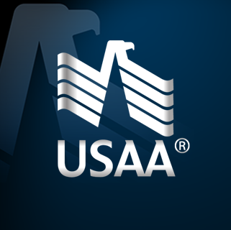

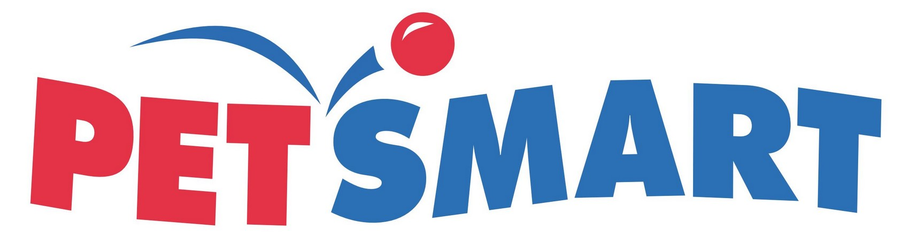














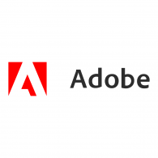



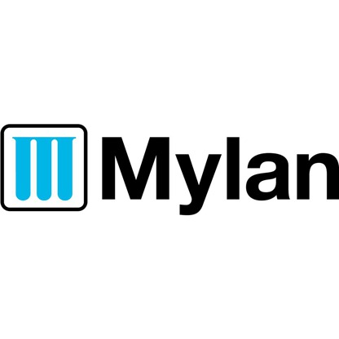

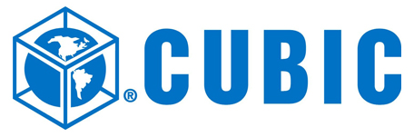


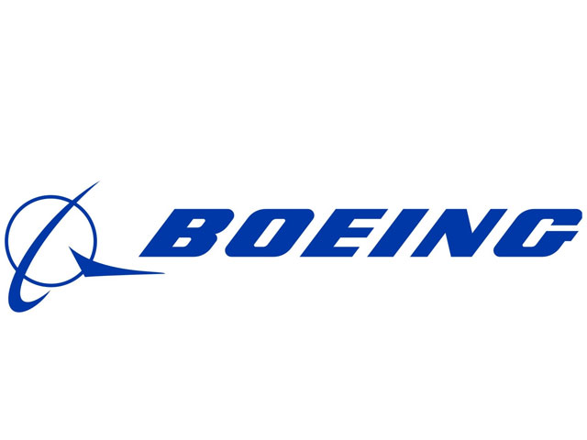

Broad Customer Adoption
Now generally available (as of March 2018)
Over 500 customers took part in the preview of Azure Databricks
Widely adopted in many industries (e.g. Retail, Media & Entertainment, Healthcare)

Slide 13




Databricks Accelerating Innovation
BUSINESS DRIVER
DESCRIPTION
CLIENT
Genomic processing takes too long and costs too much
Time required to process full exomes increases non-linearly as the number of Exomes increases. Able to leverage the elasticity of the cloud and DBR
Customer receives broad set of data requiring ETL and advanced analytics
Required a solution that was adept at ETL, Data warehousing, and advanced analytics including NLP, machine learning, that could interface with existing infr.
Massive ETL process with constantly changing input formats
Necessity to ingest and transform and load a wide variety of ever changing input streams. Traditional ETL tools couldn’t scale in performance and keep up with changes
Generalized data analytic solution for all mission centers
Predictive maintenance and age of aircraft use case based off of sensor and telemetry data collected during operations.
Notes:
s

Slide 14

Customer Case Study
INDUSTRY: MANUFACTURING
GOAL
Analyze IoT data to predict switch failures and keep customers online
CHALLENGE
Inefficient detection of equipment failures resulted in a 60% detection rate of failures, leaving customers with more downtime
DATA
2 million switch records took 6 hours to process. Increased to 10 billion records with Databricks
DATABRICKS IMPACT
10 billion records processed in 14 minutes and a 94% detection rate meant 25,000 homes were kept online resulting in a better customer experience
Notes:
Over 500 customers participated in the preview of Azure Databricks. One customer, Lennox International, is addressing thousands of consumer devices that are streaming data back to their IoT environment to identify switch failures. By implementing Azure Databricks, they have moved from 60% efficiency to 94% efficiency on detecting failures. Previously, processing 15 devices, which resulted in 2 million records took six hours. With Azure Databricks, they are able to process 25,000 devices - about 10 billion records - in under 14 minutes. But the real reason they chose Azure Databricks was because the way it enables their data science and data engineering teams to collaborate - leading to much faster innovation. This power opens the flood gates to all kinds of new use cases at Lennox.
“At Lennox International, we have 1000’s of devices streaming data back into our IoT environment. With Azure Databricks, we moved from 60% efficiency to 94% efficiency on detecting equipment failures. Using Azure Databricks has opened the flood gates to all kinds of new use cases and innovations. In our previous process, 15 devices, which created 2 million records, took 6 hours to process. With Azure Databricks, we are able to process 25,000 devices– 10 billion records – in under 14 minutes.”

Slide 15
Information Security Risk - Example
Business Challenges
Positive Business Outcomes
Threat Response & Data Eng. Teams working on separate Infrastructure
Threat Response Team has access to 2 weeks of historical data, which is insufficient to triage and investigate potential breaches
Unable to ingest and ETL a large number of data sources
Only able to write SQL Queries – unable to develop more advanced
Unification of Big Data Analytical Pipeline
Data retention of 2 years
Ingest a more comprehensive set of Data
Move from Quantitative analytics with SQL to Predictive analytics
Critical Capabilities
Business Results
Ease of Use for cluster management: creation, auto-scaling, tuning & shutdown
Ability Threat response engineers to build predictive models & leverage a distributed computation framework without Eng. assistance
Threat Response autonomously run full data sets easily at scale
Access to expertise on Spark & advance ML concepts
Customer average 20% decrease of EC2 Cost
Customer able to run investigations on 2 years of historical data which significantly reduces the Risks of a breach
Customer is able to automate investigations which reduces time to decision
Estimated Impact to Customer Business: $10M+ in savings
Cost Savings & Avoidance
Risk Mitigation
Impact Revenue and Productivity

Slide 16

The anatomy of the win Microsoft and Databricks unlock cloud analytics at Starbucks; sidelines Oracle Exadata
1
Engage the customer
2
Build the team
3
Identify priorities and challenges
4
Demonstrate proof
5
Land and expand
Internal sponsor changes the game. Starbucks had been trying to move its analytics platform to the cloud for two years to support complex modeling and analysis across its lines of business (LOBs), which would allow them to retire their on-premises Oracle Exadata system. The problem was that the HDI-based solution they were trying to implement just didn’t work despite a spiderweb of technologies they had implemented to prop it up. Then a new Director of Analytics came on board, who had just finished implementing Databricks at Nike. He immediately reached out to Databricks to see if it would work on Azure. Azure Databricks was in public preview at the time, so Databricks quickly pulled in the Microsoft team. Together they mapped out plans for a POC.
Walking in technical lock-step. Led by Microsoft CSAs Jason Robey and Ed Hagan and Databricks Solution Architect Bilal Obeidat, the technical teams for both companies worked like a single unit to develop a new reference architecture, implement the POC, and triage feature requests.
Jointly navigating the business. Romeo Bolibol, Sr. AE, Tony Clark, Databricks AE, and Pouneh Partowkia, Databricks Alliance Lead, used their respective connections to build support across cloud, BI, and LOB decision makers, with Nate Shea-han, GBB, serving as the catalyst between Microsoft and Databricks.
Power sponsor a key factor. Because the Director of Analytics knew what the solution could do first hand, the team didn’t need to spend time on building credibility.
Unlocking the cloud. Starbucks wanted to deprecate Oracle Exadata. But after two years, they had only enabled 15 (out of 300+) data scientists and analysts on an HDI-based cloud solution, so teams kept falling back to old system. Microsoft and Databricks started from scratch with a new reference architecture that would support all required use cases and provide cloud efficiencies.
One advanced analytics solution for all businesses and roles. Starbucks wanted a single data lake that every line of business could leverage. Azure Databricks deployed with Azure Data Lake Store provides the central advanced analytics and data lake platform. Starbucks data engineering, data scientist, and data analyst teams can all work in the same place, decreasing time to market.
POC proves velocity and security. The POC was geared toward proving the solution can deliver the speed to market Starbucks wanted while also meeting their stringent security compliance requirements. Azure Databricks integration with Azure Active Directory was a big help on the security front. And after seeing Azure Databricks in action, the marketing team estimated it will drive $100M annually in top-line revenue growth and efficiencies.
Near-term ROI. Cost recovery from Exadata would be slow, so Starbucks needed to show near-term ROI. The team got very creative, using $800K in ECIF ($300K in HDI consumption credit during migration and $500K in services). Databricks also contributed $1.4 million in services.
Azure Databricks is Starbucks’ Unified Analytics Platform. After 11 months of engagement, Starbucks committed to Azure Databricks as their advanced analytics platform. Marketing analytics will be the first use case deployed, with 9 additional use cases planned, such as supply chain, loyalty, and fraud detection. Starbucks has committed to $5M in Databricks licenses, driving $16M in Azure consumption over 2.5 years. There is opportunity for exponential growth as new use cases are developed.
What’s next? One immediate opportunity the team is pursuing is how Azure Databricks could be rolled out to China – Starbucks’ biggest growth market.
Key Resources
Key Resources
Key Resources
Key Resources
Key Resources
Databricks
POC
ECIF
CSAs Databricks
Databricks
Notes:
Azure Databricks is being deployed at Starbucks as the Data Lake (on ADLS), ETL layer, and advanced analytics platform.

Slide 17
Microsoft Overview

Slide 18
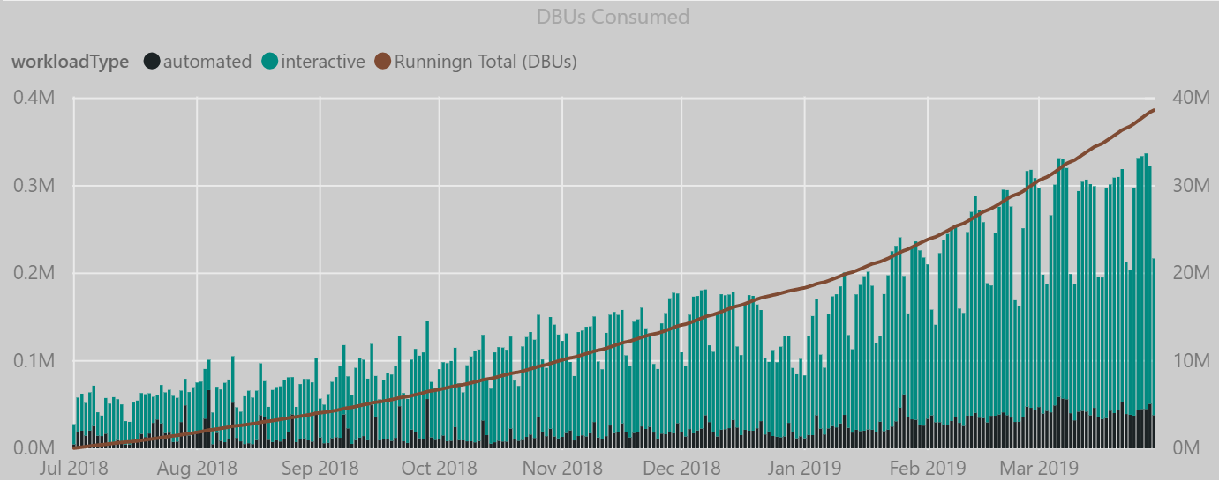
Results

Slide 19
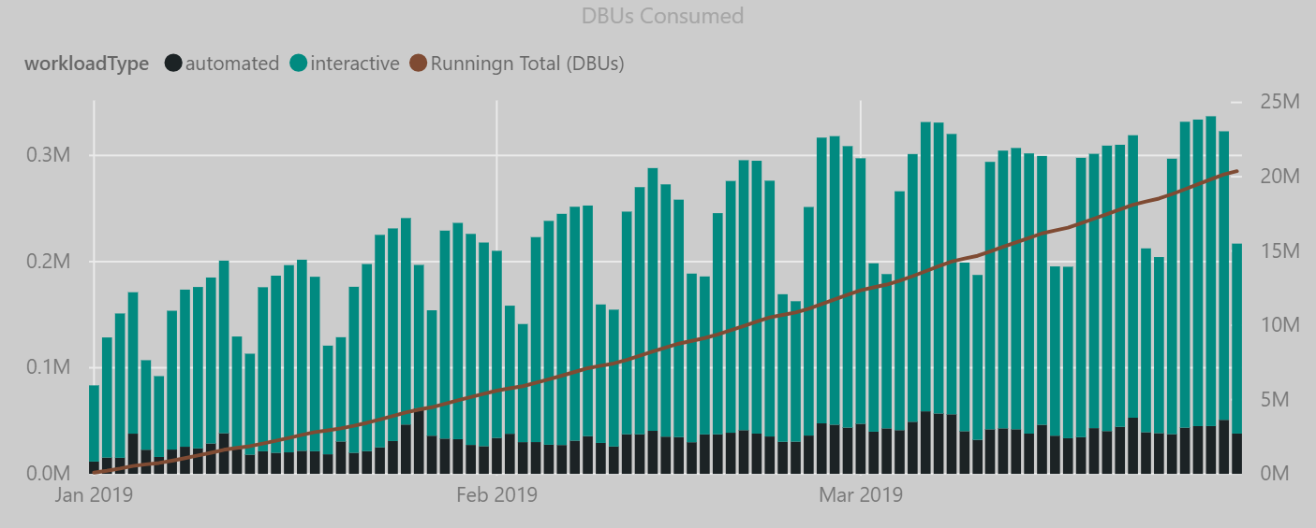
Results

Slide 20
Q5 Pipeline Generation Targets
LMCO = Analytics (Baylor)/ Security (Gordon)
1
NGC = ESS Analytics (Vitek)/ Security (Raber/ Papay)
2
RTN = GBS Analytics (Lee)/ Security (Brown/ Costa)
3
MITRE = Analytics (Sorensen)/ Security (Finn)
4
5
ULA = Analytics / Security (IBM)
6
General Dynamics = Analytics (?) / Security (Baker/ Olmstead)
7
HII/ NNS = Analytics (Bharat) / Security (Forest (ret)
SAIC = Analytics (? not Chitra, Onstatt) / Security (Lynch/ )
8
Notes:
MIKE
We’ve got about 10-15 mins of presenting, so I’ll run through this as athletically as I can to go over:
What we heard from you Waqas on our Discovery call
What is Spark
Our Vision & Product
Take a look at our customer landscape and dig into some high level customer stories
Dive into our Databricks unified analytics platform, which will include a product demo
And finally - talk through next steps
Of Note - Typically activities after these presentations - we usually schedule a follow up review session w/ our Security team to ensure there are no showstoppers and/or kick off discussions specific to spinning up a PoC around use cases that we will work to define.
Does that sound good?

Slide 21
Action Plan -
Here is my ask:
1 hour strategy session on each account
Who, what, where?
Specific Uses Cases for DB and the SSP/ PS team to target
Targeted plan to POC in each account/ multiple BUs or Divisions
Let’s get this party started!
Complete the above by 6/21
Report out to Yagy and Davis on the plan6/25 (e-mail)

Slide 22
Azure Databricks
For more information: databricks.com/azure
Get Started with Azure Databricks: http://bit.ly/AzureDatabricks
Notes:
You can get more information about Azure Databricks at databricks.com/azure.
Get started with Azure Databricks at bit.ly/AzureDatabricks

Slide 23
End

